Slide 1
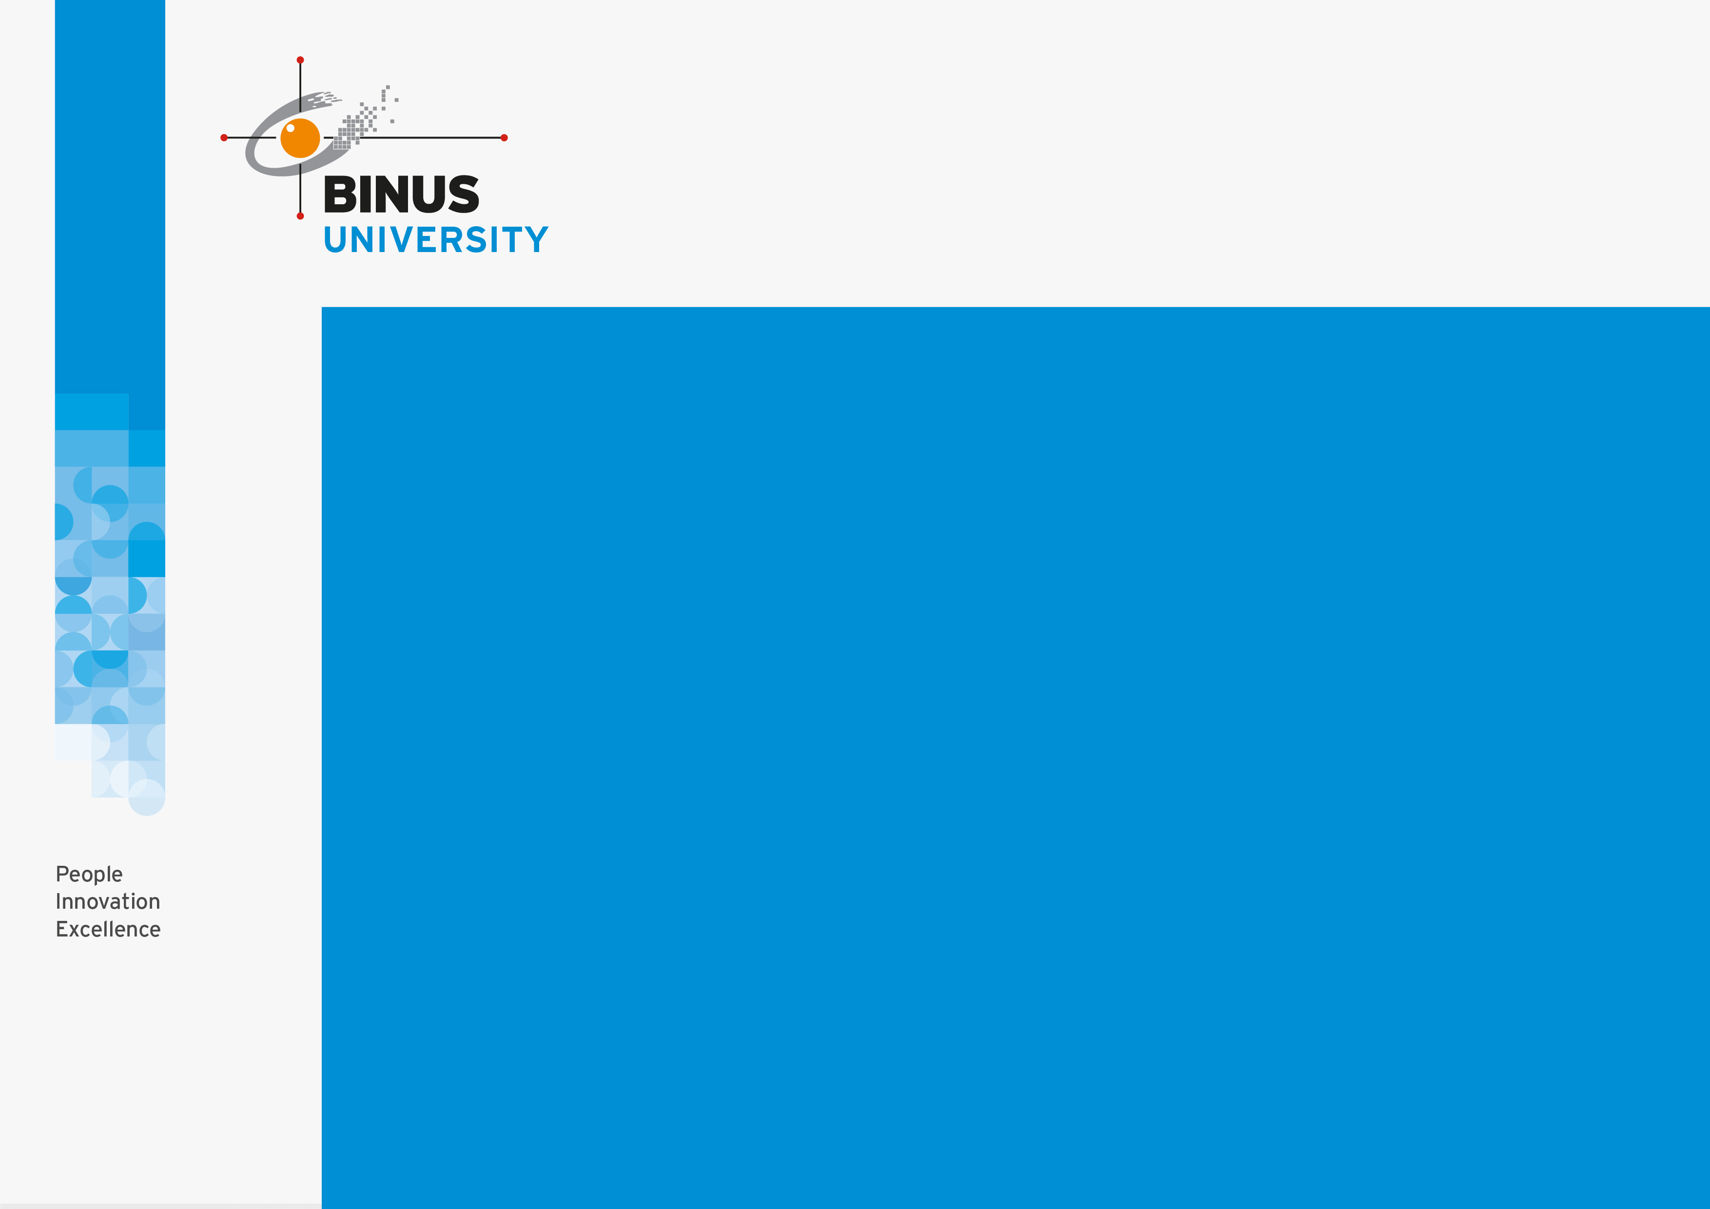
Course : COMP6232 / Human - Computer Interaction
Year : 2016
EMOTIONAL INTERACTION
SESSION 05

Slide 2
  LEARNING OUTCOMES
LO 1: Describe the concept of interaction design
LO 2: Use guidelines, principles ,models, and framework related with interaction design

Slide 3
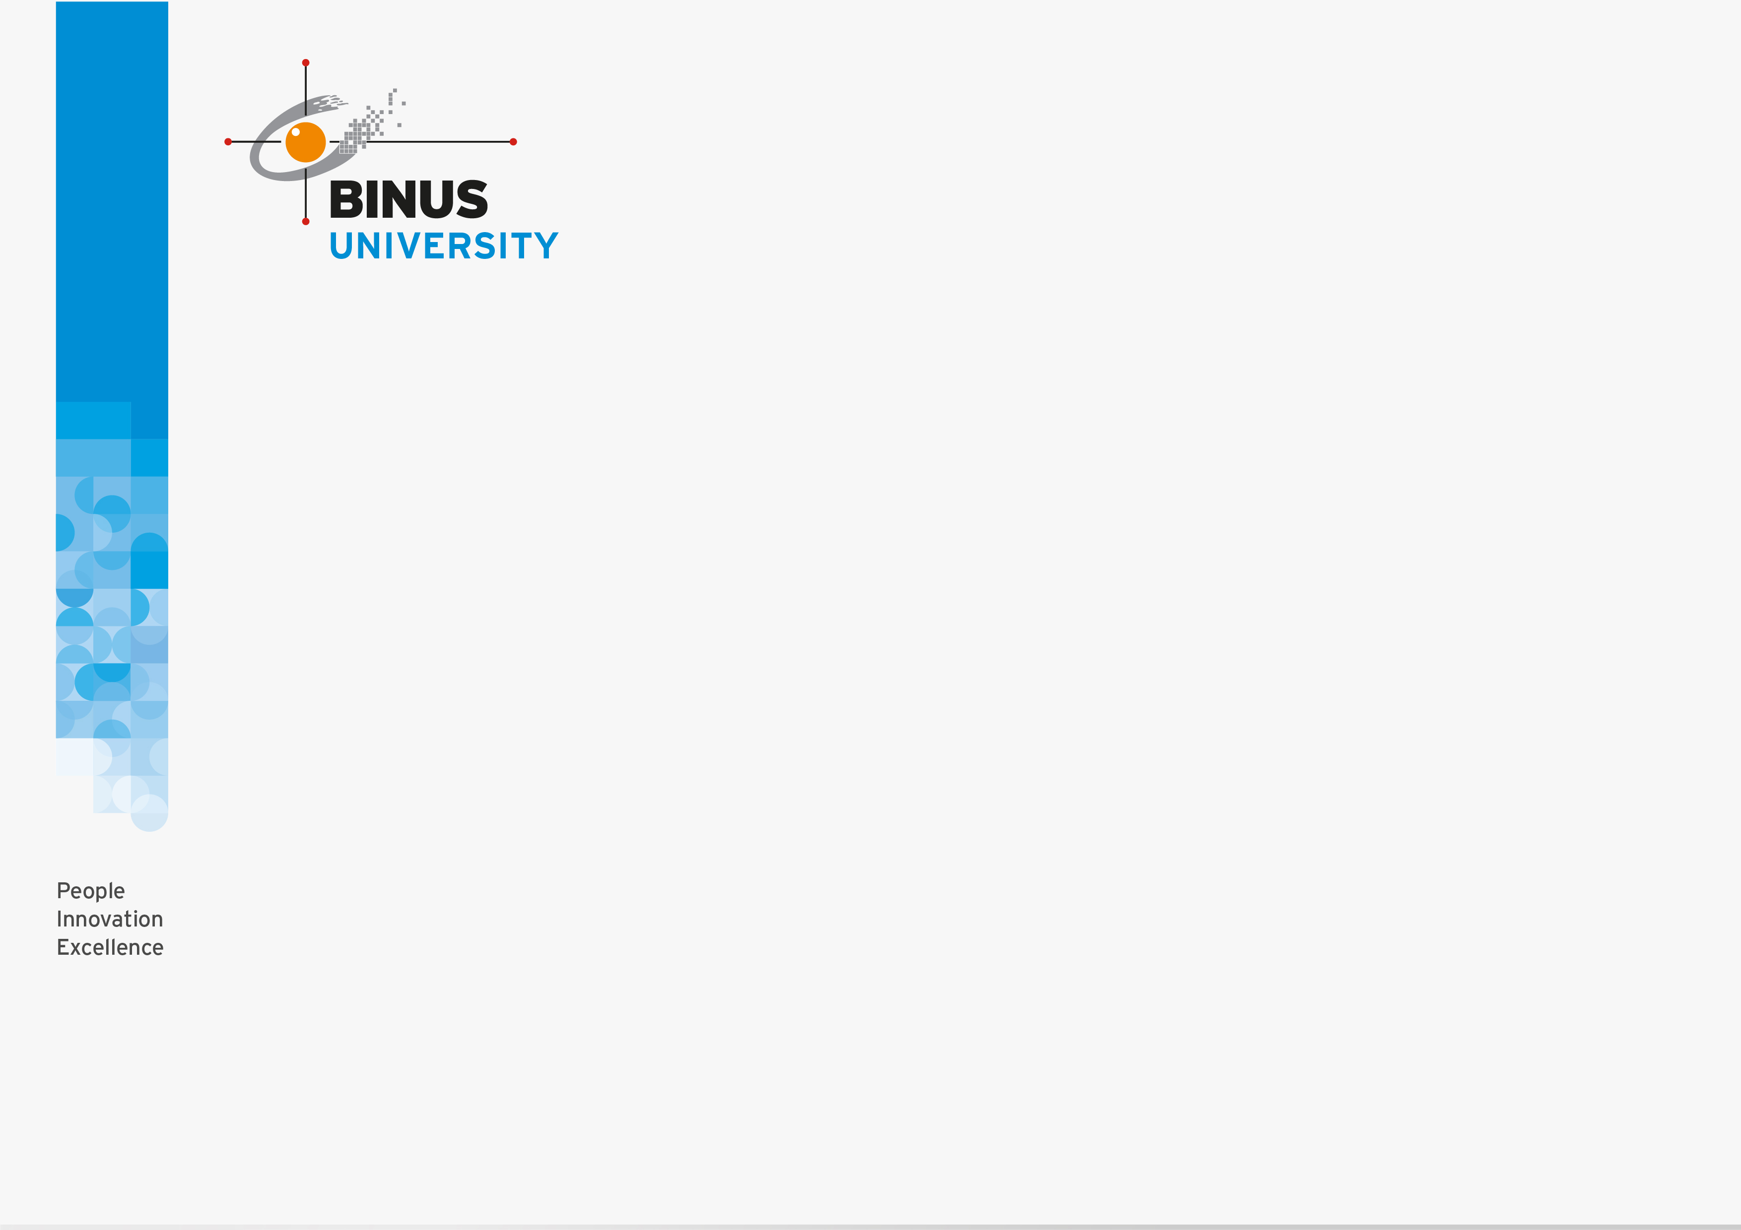
OUTLINE
Introduction
Emoticons and The User Experience
Expressive Interfaces
Frustrating Interfaces
Persuasive Technologies and Behavioural Change
Anthropomorphism and Zoomorphism
Models of Emotion

Slide 4
INTRODUCTION
An overarching goal of interaction design is to develop products that elicit positive responses from users, such as feeling at ease, being comfortable and enjoying the experience of using them.
There also been much interest in designing websites that people can trust and that make them feel comfortable about divulging personal information when making a purchase.

Slide 5
EMOTIONS AND
THE USER EXPERIENCE
Emotional interaction is concerned with how we feel and react when interacting with technologies
It covers different aspects of the user experience, from how we feel when first finding out about a new product to getting rid of it.
It also looks at why people become emotionally attached to certain products e.g virtual pets, how social robots might help reduce loneliness and how to change human behavior through the use of emotive feedback.

Slide 6


EMOTIONS AND
THE USER EXPERIENCE
A good place to start understanding how emotions affect behavior and how behavior affect emotions is to examine how people express themselves and read each other’s expressions.
These include understanding the relationship between facial expressions, body language, gestures, and tone of voice.
For example when people are happy they typically smile, laugh, and open their bodies up. When they are angry they shout, gesticulate, and screw up their face.

Slide 7
EMOTIONS AND
THE USER EXPERIENCE
Emotional skills, especially the ability to express and recognize emotions, are central to human communication.
In additions to creating user experiences that elicit, avoid, or encourage certain kinds of emotional reactions, another approach called affective computing , has attempted to develop computer-based systems that recognize and express emotions in the same way humans do (Picard,1998).
However, it should be stressed that designing computers to artificially care for humans, through listening, empathizing and being cheerful, is not viewed as a replacement for human care but as an aid.

Slide 8
EXPRESSIVE INTERFACES
Expressive forms like emoticons, sounds, icons, and virtual agents have been used at the interface to :
  Convey emotional states
  Elicit certain kinds of emotional responses in users, such as feeling at ease, comfort, and happiness.
A classic from the 1980s and 1990s was the happy Mac icon that appeared on the screen of the Apple computer whenever the machine was booted (Figure 5.1a) or sad icon face (figure 5.1b) or Mac icon shows its face on a iPod (figure 5.1c).

Slide 9

EXPRESSIVE INTERFACES
Figure 5.1 Smiling and sad Apple icons for the classic Mac (a) and (b) and for the ipod (c)
One of the benefit of using these kinds of expressive embellishments is provide reassuring feedback to the user that can be both informative and fun.

Slide 10
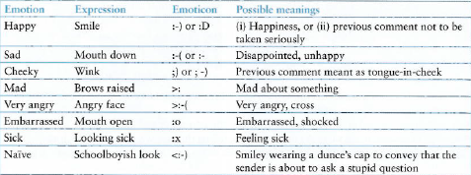
EXPRESSIVE INTERFACES
A universal method is the use of emoticons, originally keyboard symbols that were combine in various ways to convey feelings and emotions by simulating facial expressions such as smiling, winking, and frowning on the screen.(See Figure 5.2)
Figure 5.2 Some commonly used emoticons

Slide 11
FRUSTRATING INTERFACES
In many situations, computer interfaces may inadvertently elicit negative emotional responses, such as anger and disgust.
This typically happens when something that should be simple to use or set turns out to be complex.
For example : Clippy ( a paper clip that has human-like qualities) as part of Window 98 operation environment. Many of user found it very trying and intrusive, distracting them from their work.

Slide 12
FRUSTRATING INTERFACES
Interfaces, if designed poorly can make people look stupid or feel insulted or threatened. There are many reasons why such emotional responses occurs :
  When an application doesn’t work properly or crashes
  When a system doesn’t do what the user wants it to do
  When a user’s expectations are not met.
  When a system does not provide sufficient information to let the user know what to do.
  When error message pop up that are vague or obtuse.
  When the appearance of an interface is too noisy ,garish, gimmicky or patronizing.
  When a system requires users to carry out too many steps to perform a task, only to discover a mistake was made somewhere along the line and they need to start all over again.

Slide 13
FRUSTRATING INTERFACES
Some reason that can make user frustrations because of bad interfaces :
  Gimmicks
  ex : frustration can happen when clicking on a link to a website only to discover that it is still under construction
  Error Message
  Threatening error message can also cause users to become anxious.
  Waiting
  Ex : websites or software apps that for ever to download

Slide 14
FRUSTRATING INTERFACES
  Upgrading
  More often than not it is time-consuming, requiring a range of things such as resetting preferences, checking other configurations and learning new ways of doing things.
  Appearance
  People are often annoyed by appearance of text and graphics on websites, flashing animations, the over-use of sound effect and music, featuritis, childish design, poorly laid out keyboards, pads, or control panels

Slide 15
Persuasive Technologies
and Behavioral Change
A diversity of technologies is increasingly being used to draw people’s attention to certain kinds of information in an attempt to change what they do or think.
Pops-up ads, warning messages, reminders, prompts, personalized messages, and recommendations are some of the methods that are being deployed on computer screens.
Phenomenon persuasive technology : interactive computing systems are deliberately designed to change people’s attitudes and behaviors. (Fogg,2003).

Slide 16
Persuasive Technologies
and Behavioral Change
Example :
  Amazon’s one click mechanism makes it so easy and tempting to buy something at their online store,
  Nitendo’s Pokemon Pikachu 2 GS with pedometer attached that was designed to motivate children into being more physically active on a consistent basis.
  The WaterBot system was developed using a special monitoring and feedback device but for adults as a way of reducing their usage or water in their homes.

Slide 17
ANTHROPOMORPHISM
AND ZOOMORPHISM
Anthropomorphism is :
  The propensity people have to attribute human qualities to animals and objects
  For example : the development of computer-based cuddly toys such as Barney was programmed to congratulate the child whenever she produced a right answer.
Zoomorphism is :
  The shaping of an object or design in animal form.
People especially children have a propensity to accept and enjoy objects that have been given human-like qualities has led many designers to capitalize on it.
Most notably in the design of human-computer dialogs modeled how on human talk to each other.

Slide 18
MODELS OF EMOTION
The goal to use other theories of emotion and pleasure from other disciplines in interaction design is to help designer understand how people react and respond when in different contexts and to help them know how to design for or try to reduce certain emotions.
Emotional Design Model
Emotional Design Model by Ortoni et al (2005) contain three different levels of the brain (Fig 5.3):
  Visceral level
  Behavioral level
  Reflective level

Slide 19
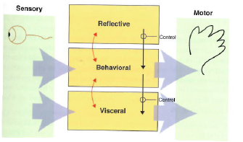
MODELS OF EMOTION
Figure 5.3 Ortony et al (2005) model of emotional design. The arrows refer to how the different levels are affected by each other.

Slide 20
MODELS OF EMOTION
The Visceral Level
  At the lowest level are parts of the brain that are pre-wired to automatically respond to events happening in the physical worlds.
  Respond rapidly,
  Making judgments about what is good or bad, safe or dangerous, pleasurable or abhorrent
  Triggers the emotional responses to stimuli ( e.g. fear, joy, anger, sadness) that are expressed through a combination of physiological and behavioral responses.

Slide 21
MODELS OF EMOTION
The behavioral level
  The site where most human activities occur, examples talking, typing, and driving
  The brain processes that control our everyday behavior
The reflective level
  The highest level are brain processes that contemplate.
  Entails conscious thought where people generalize across events or step back from the routine and the immediate.
  An example is switching between thinking about the narrative structure and special effects used in Harry Potter movie and becoming scared at the visceral level when watching the movie.

Slide 22
MODELS OF EMOTION
The model explains how the human brain and the body switch gear to respond appropriately to different events. But how can it be used in interaction design ?
A less controversial application of the model is to think about how to design products in terms of the three levels.
Visceral design refers to making products look, feel, and sound good. The designer can use a number of aesthetic techniques such as clean lines, balance, color, shape and texture. For example : the iPod

Slide 23
MODELS OF EMOTION
Behavioral design is about use and equates with the traditional values of usability.
Reflective design is about taking into account the meaning and personal value of a product in a particular culture. For example : the design of a Swatch watch, brilliant color, wild design, and art are the Swatch trademark.
Pleasure Model
Pleasure Model by Jordan’s (2000) focuses on the pleasurable aspects of our interactions with products.

Slide 24
MODELS OF EMOTION
Based on Tiger’s (1992) framework of pleasure, there are four types of pleasure :
  Physio-pleasure : bodily pleasure connected to sensory experiences e.g touch, taste and smell.
  Socio-pleasure : the enjoyment of being in the company of others, such as loved ones, friends, and colleagues. Example : showing photo to another via display on digital camera that someone has just taken at a friend’s birthday.
  Psycho-pleasure : refer to people’s emotional and cognitive reactions to a product.
  Example : the satisfying experience of shopping on the web using an online site

Slide 25
MODELS OF EMOTION
  Ideo-pleasure : refer to people’s value and is akin to the reflective level of Norman’s model.
  Example : a person buys a hybrid car that runs on a combination of electricity and gas may derive more ideo-pleasure using it because it is saving energy and is cheaper to run.
Technology as Experience Framework
Another popular model that accounts for the user experience largely in terms of how it is felt by the user is technology as Experience Framework by McCarthy and Wright’s (2004).

Slide 26
MODELS OF EMOTION
McCarthy and Wright propose four core threads :
  The sensual thread : concerned with our sensory engagement with a situation and is similar to the visceral level of Norman’s model.
  The emotional thread : points out how emotions are intertwined with the situation in which they arise.e.g a person becomes angry with a computer because it does not work properly.
  The compositional thread : concerned with the narrative part of an experience, and the way a person makes sense of them.

Slide 27
MODELS OF EMOTION
  The spatio-temporal thread : refers to the space and time in which our experiences take place and their effect upon those experiences.
  For example : we talk of time speeding up, standing still, and slowing down , while we talk of space in terms of public and personal places, and needing one’s own space.
The threads are meant as ideas to help designers think and talk more clearly and concretely about the relation-ship between technology and experience.

Slide 28
EMOTION ENGINEERING
Emotion Engineering
  To make game more interesting we can use emotion engineering, by exploiting human nature habits
    Nurturing Instinct : Empathy + Agency + Comfortable routine + Surprise + Naches
    Flow : Exhilaration + Confidence + Coherence + Forward thrust – Boredom
    Being Hunted : Dread + Unpredictability + Caution + Anticipation of failure - Hope

Slide 29
EMOTION ENGINEERING
Nurturing Instinct
  Empathy (Persistent High Data at the System level): Consistent behaviors from game entities (Player can understand the creatures and anticipate their behaviors), Emergent behavior (Creatures are complex enough to seem intelligent and aware of the interactions), Preparation (Player's actions take some effort which increases their perceived value), Ability customization (Creatures respond differently to customized tools, as is they have tastes and preferences), Learning a rule (Creatures are complex enough that the player must spend time to learn their behaviors), Score increase (Creatures give positive feedback when pleased).
  Agency (Persistent High Data at the Action level, Persistent High Mastery at the System level): Permanent world change (Player's actions change the creatures, Mistakes can hurt them), Collectibles (Customized tools, Rare behaviors, Rare creatures), XP (System level track of progress and effort needed), Resources (Put the emphasis on the cost of interaction and the player's commitment) (Treats, Meds), Voluntary gameplay mode switch (Player can choose the creatures' activities), Lowering difficulty of current challenge (Slow rhythm, No pressure, No insurmountable challenges), Iconic / Symbolic content with clear affordance (Tools' and activities' functions are clear, one per tool or activity), Positive & negative feedbacks (Creatures show the player whether an interaction is pleasing or not), New long-term goal (Creatures express needs that take a lot of effort to satisfy).

Slide 30
EMOTION ENGINEERING
Nurturing Instinct
  Comfortable routine (Decrease when High Freedom at the System level): Guidance / Clear goal (Creatures' needs generate challenges, Challenge solution is often obvious; it requires investment, not skill), Simulation conventions (Whether inactivity is perceived by the creatures, Whether challenges can be concurrent, etc.), Clear chosen goal (Player can work toward a specific change in the creature) (Creature evolution, Creature training), Local resolutions (Medium-term challenges with little impact on global change, Mistakes can be corrected).
  Surprise (Increase when Low Freedom at the System Level, Decrease when High Mastery at the System level): Unlocking content / Inconsistent or random behaviors (Breaks the routine's monotony) (Rare events, random or with rare conditions), Easter eggs (Reward experimentation with creatures).
  Naches (Pride for one's child's or mentee's accomplishments) (Increase when High Mastery at the Social level): Mentoring (Player can give goals and progress feedback to the creatures), Cooperation (Creature skill acquisition requires a tight feedback loop with the player), Correct response to cultural cue (Creatures display signs of effort when learning, Creatures' skill acquisition is punctuated by joyful behavior on their part), Teaching a skill / Recurring opponent's mistake (Creatures have disabilities that they can overcome through being taught).

Slide 31
EMOTION ENGINEERING
FLOW
  Exhilaration (Persistent High Freedom at the Action level): Action opportunities (Limited constraints on move set, Short-term athletic skill challenges), Resource gain (Steady flow to feed preparation or positive feedback - see below).
  Confidence (Persistent High Mastery at the Action level): Affordance (No ambiguous stimuli), Highly trained reflexes / Kinesthetic isomorphism (Player can play without thinking about the controls), Advantage opportunities (Player can identify which sequences of moves can solve local challenge).
  Coherence (Persistent High Mastery at the System level): Consistent behaviors from game entities (Player can predict next game state and react accordingly), Positive feedback (Reward local successes with easy challenges, power increase or score multipliers), Hints (Warn the player of imminent danger), Opportunities for exploiting preparation (Short-term tactical combos), Voluntary gameplay mode switch (Player can use favorite tactics), Opportunities for taking the lead (Player catch-up), Opportunities for exploiting emergent behavior (Chain reactions, Player can provoke opponent's mistakes).

Slide 32
EMOTION ENGINEERING
FLOW
  Forward thrust (Increase when High Freedom at the System level): Alternative methods / Concurrent goals (Player can use favorite tactics), Generating opportunities (Even if caught off-guard, player can maneuver so he can fall back to favorite tactics), Safeguards (Player can recover from near defeat).
  Avoid Boredom (No Excess Mastery at the Action or System levels): Difficulty increase, Complexity increase, Involuntary gameplay mode switch, Random behaviors (Sustained level of perceived difficulty at the Action level, Use semi-random temporary increases in difficulty to keep the player on his toes) (Waves of enemies, One unpredictable enemy type, Periods of low availability of tactical resources).

Slide 33
EMOTION ENGINEERING
BEING HUNTED
  Dread (Persistent Low Freedom at the Action level): Linear path (Limited number of significant path choices, Limited number of hiding places), Temporary loss of ability (Being slowed down by a wound), Resource loss (High cost for being caught), Limited opportunities to escape when seen.
  Unpredictability (Decrease when High in Mastery at the System level): Negative feedback (Hunters catch-up, No possible escape), Inconsistent or random behaviors (Hunters cannot be tracked or their positions predicted), Involuntary gameplay mode switch (Stealth / Flight).
  Caution (Persistent Low Mastery at the Action level): Taking a risk (Risky portions in main path or secondary path, where the player can be spotted more easily), Misdirecting affordance (Traps).

Slide 34
EMOTION ENGINEERING
BEING HUNTED
  Anticipation of failure (Persistent Low Mastery at the Self level): Pretend danger (Ominous noises), Perceived cheating on the part of the game (How can they always find me?), Opportunities for recurring mistake (Hunters can hear the player when he makes noises).
  Avoid Hope (No Increase when Low in Mastery at the Action level, Freedom at the System level and Mastery at the System level): Can't exploit advantage opportunity (Hunters show no weaknesses), Can't pursue concurrent goals (Fleeing prevents access to resources or means of escape), Can't exploit preparation (Hunt can only end by a narrow escape that feels lucky).

Slide 35
REFERENCES
https://www.cs.rochester.edu/courses/112/spring2013/10chapter5.pdf
http://www.peter-lo.com/Teaching/IT359/L05.pdf
Grounded Zoomorphism : dl.acm.org/citation.cfm?id=2693796
http://bjfogg.com/fbm_files/page4_1.pdf

